Slide 1
Setting up a University in UAE
BY
Aamna Khalid

Slide 2
Problem
Identifying the right location for opening up a university within UAE based on the following factors:
Frequency of universities in the selected city
Distance of the existing universities from the city center
Significance of the city from an international perspective

Slide 3
Research Methodology
The following methodology was used:
Importing Libraries
Numpy
Panda
Four Square API
Venues
Near Query
Category ID
Folium
Three Cities
City Centre Coordinates

Slide 4
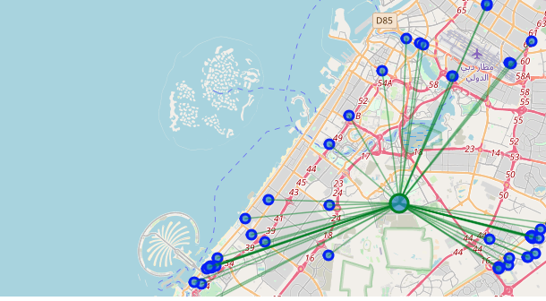
Visualization of Universities in Dubai

Slide 5
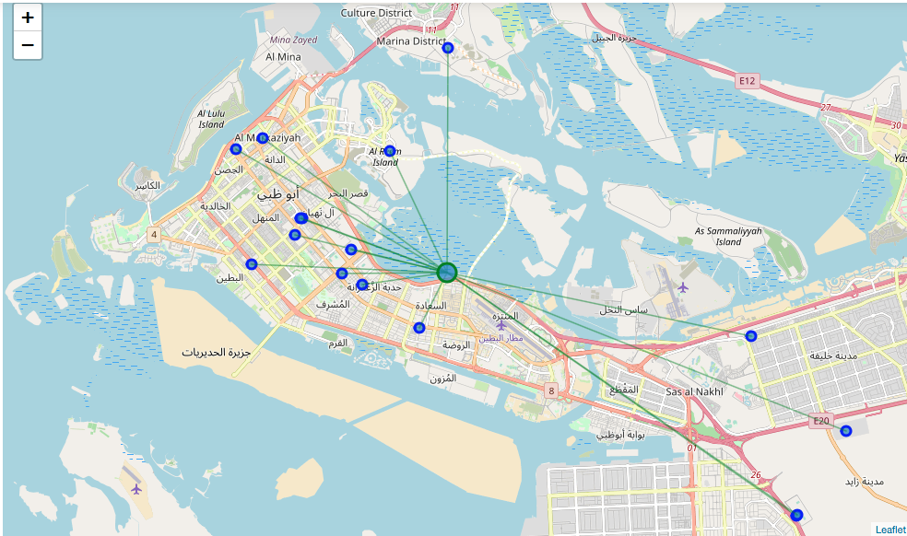
Visualization of Universities in Abu Dhabi

Slide 6
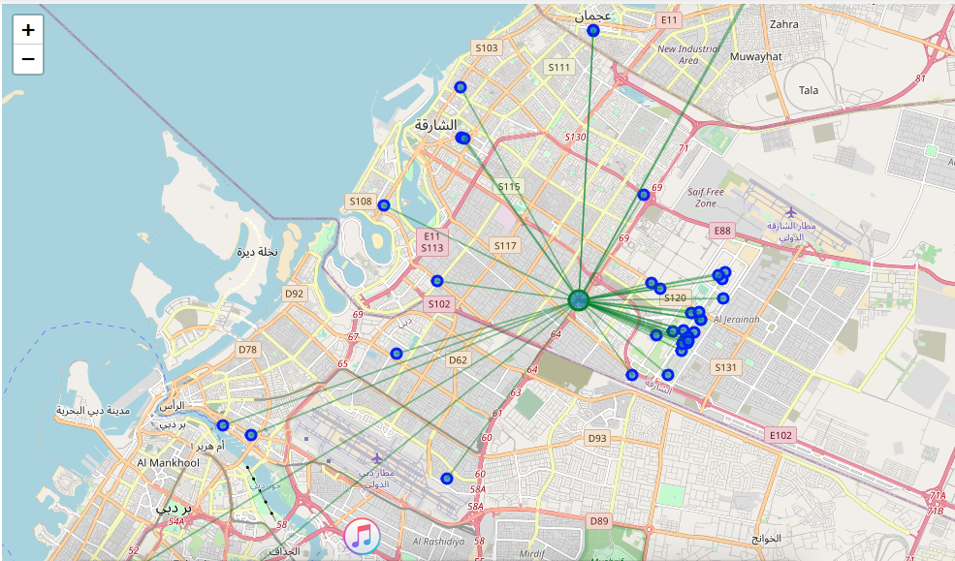
Visualization of Universities in Sharjah

Slide 7
Conclusion
The following factors were used to finalize on the ideal location for the client:
Frequency
Distance from City Centre
City’s Significance
As a final result, Abu Dhabi was selected as the location for the client.

